Slide 1
Sorting and Searching

Slide 2
Sorting
Given a list (array) of things in shuffled order, put them in the correct order (non-decreasing).
There are many ways to perform sorting:
Bubble Sort
Insertion Sort
Selection Sort
Merge Sort
Quick Sort
Heap Sort / Priority Queue
Balanced Binary search Tree / Map

Slide 3
Sorting in Languages
For us, C++ STL has sort(), which is a hybrid of different kinds of sort algorithm and quite fast. It works in O(n log n)
int arr[5];
sort(arr, arr+5)
30 | 10 | 40 | 20 | 10
10 | 10 | 20 | 30 | 40
vector<int> v
sort(v.begin(), v.end())
Java also has sorting functions. For arrays use Arrays.sort() and for ArrayList use Collections.sort(). But Arrays.sort() can have quadratic
Complexity.
Either use Collections.sort() for java or shuffle the array before sorting.

Slide 4
C++ sort can be used to sort a range instead of the whole array
80 | 70 | 60 | 50 | 40 | 30 | 20 | 10
Before Sort
Suppose we want to sort the elements from index 4 to index 6. The container is arr (array) or vector (v)
80 | 70 | 60 | 50 | 20 | 30 | 40 | 10
After Sort
Then call sort(arr+4, arr+7) or sort(v.begin()+4, v.begin()+7).
Remember that the range should be [begin, end). Begin included
End excluded.

Slide 5
Suppose we want to remember the original order of the elements i.e. If the original array was [50, 20, 40, 10, 40, 30], the output should be [3, 1, 5, 2, 4, 0] (original indices). We can do that too.
The idea is to use pairs. Instead of keeping just x, keep (x, i), where i is the original position.
(50, 0) | (20, 1) | (40, 2) | (10, 3) | (40, 4) | (30, 5)
sort
(10, 3) | (20, 1) | (30, 5) | (40, 2) | (40, 4) | (50, 0)
This also ensures stability. In case of equal elements, those with smaller index are before those with larger index.

Slide 6
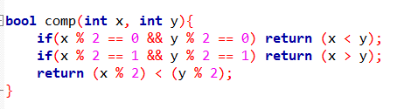
We can also use a custom sorting operator to sort with new order. Java also has this feature with comparator interface.
Suppose we want to sort numbers such that evens come first and odds come later, evens should be non-decreasing, while odds should be non-increasing.
We have to make a function bool comp(int x, int y), which will return true iff x will be before y in our order.
For the above scenario following function works
By the way, this is wrong for negative numbers
To use this operator use sort(begin, end, comp);

Slide 7
Event Processing
In problems related to intervals, event processing idea is that we process the beginning and ending of each interval.
Every interval [l, r] has two events: one at l, the starting event & one at r, the ending event.
To process both, we put them in a vector and sort. However we need to differentiate between starting and ending, so we use pairs.
A starting event is put as (l, 1) while ending event is put as (r, -1)
Note that for same coordinate, ending event comes first in this system.
What if we wanted the reverse?

Slide 8
Problem: Given some intervals [l, r], what is the maximum number of intervals, some coordinate x was part of?
Examples: Suppose the intervals are [2, 8], [1, 4], [5, 8], [8, 10], [9, 11] then answer is 3.
1 2 3 4 5 6 7 8 9 10 11
1 1 2 2 2 2 2 1 2 2 2 2 2 2 3 1 2 2 2 1 1
The idea is that we process the events and keep track of how many intervals are active.

Slide 9
Problem: Given some intervals [l, r], what is the maximum number of intervals, some coordinate x was part of?
1 2 3 4 5 6 7 8 9 10 11
The events are
(1, -1), (2, -1), (4, 1), (5, -1), (8, -1), (8, 1), (8, 1), (9, -1), (10, 1), (11, 1)
+1 +1 -1 +1 +1 -1 -1 +1 -1 -1
Every event (x, -1) increases active count while event (x, 1) decreases active count.

Slide 10
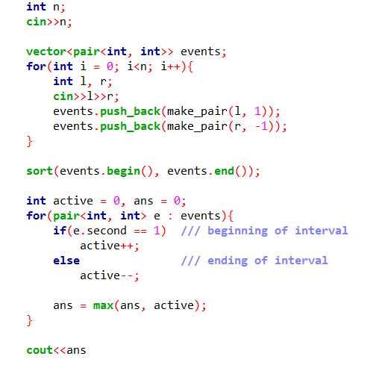
Problem: Given some intervals [l, r], what is the maximum number of intervals, some coordinate x was part of?

Slide 11
Application of Event Processing
Same problem as last one, but what if the intervals were open intervals i.e. (l, r)? [solution: change convention, beginnings are (x, 1) while ends are (x, -1)]
Given some intervals, output count of x such that they were covered by at least one interval.
If intervals have associated cost with them, you can use pair<pair<int, int>, int>, which would be of format ((coordinate, cost), sign)

Slide 12
Searching
The naïve searching method is that of linear search, use a loop and search. This is slow as it takes O(n) time.
We can do better if the initial list is sorted. Consider finding whether a sorted array of numbers contains x.
Binary search keeps an active range and always searches in the middle. If middle element was not x, it goes to some half.
Time taken is O(log n)

Slide 13
Suppose we want to search for 70 in the following array.
10 | 20 | 30 | 40 | 50 | 60 | 70 | 80 | 90 | 100
Current range: (0, 9) and mid = (0+9)/2 = 4
10 | 20 | 30 | 40 | 50 | 60 | 70 | 80 | 90 | 100
Current range: (5, 9) and mid = (5+9)/2 = 7
10 | 20 | 30 | 40 | 50 | 60 | 70 | 80 | 90 | 100
Current range: (5, 6) and mid = (5+6)/2 = 5
10 | 20 | 30 | 40 | 50 | 60 | 70 | 80 | 90 | 100
Current range: (6, 6) and mid = (6+6)/2 = 6
70 is found at index 6.

Slide 14
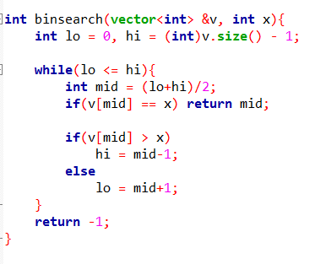
Since the current range halves every step, the complexity is O(log n)
Here is one possible implementation:
However C++ has 3 variations of binary search in STL already.

Slide 15
STL Binary Search
binary_search(begin, end, x) : returns true or false, whether x is in the array or not.
lower_bound(begin, end, x) : returns first iterator that is >= x.
upper_bound(begin, end, x) : returns first iterator that is > x.
A great functionality is that upper_bound(x) – lower_bound(x) will give us how many x there are in the array.
To check whether x is inside the array, first assign lower_bound(x) to a variable it, then check if (it != v.end() && *it == x)

Slide 16
Problem: Given an array of numbers and a target x, output two different indices such that their value sum to x.
Solution:
The naïve way is to do a nested loop and test all arr[i] + arr[j]. This is quadratic in complexity.
But we know that the target is x, so if we fix arr[i], we need to know whether x – arr[i] is in the array too, a searching problem.
So sort the array, fix arr[i], binary search for x-arr[i].
But binary search can return arr[i] itself. So search on the range [0 … i-1]
We also need original indexes, so use pairs.
But then we need to use lower_bound with pair (x-arr[i], 0). [ if second element wasn’t 0, would there be problems?]

Slide 17
A Different Perspective into Binary Search
Instead of thinking of binary search as a searching algorithm, think of it as a partitioning algorithm.
In an array, some prefix has true values, and the remaining suffix has false values, our goal is to find the partitioning point.
T | T | T | T | F | F | F | F | F | F
Partitioning Point
Binary search can help us find this partitioning point. Now, the conditions are: if (v[mid] == true) lo = mid+1, else hi = mid-1.

Slide 18
T | T | T | T | F | F | F | F | F | F
lo hi
T | T | T | T | F | F | F | F | F | F
lo hi
T | T | T | T | F | F | F | F | F | F
lo hi
T | T | T | T | F | F | F | F | F | F
lo/hi
T | T | T | T | F | F | F | F | F | F
hi lo
After loop breaks, hi will point to last true and lo will point to first false

Slide 19
Some Problems using partitioning idea
A sorted array is cyclically shifted, for example: [10, 20, 30, 40, 50, 60] is changed to [30, 40, 50, 60, 10, 20], find the shifting length.
A bitonic array is given, i.e. the values first increase then stay same then decrease : [10, 20, 30, 40, 40, 40, 35, 25, 5, 0], find the maximum element.
A sorted array of n-1 length has elements all of 1, 2, …, n except one element, for example: [1, 2, 3, 4, 6, 7, 8], find the missing element.

Slide 20
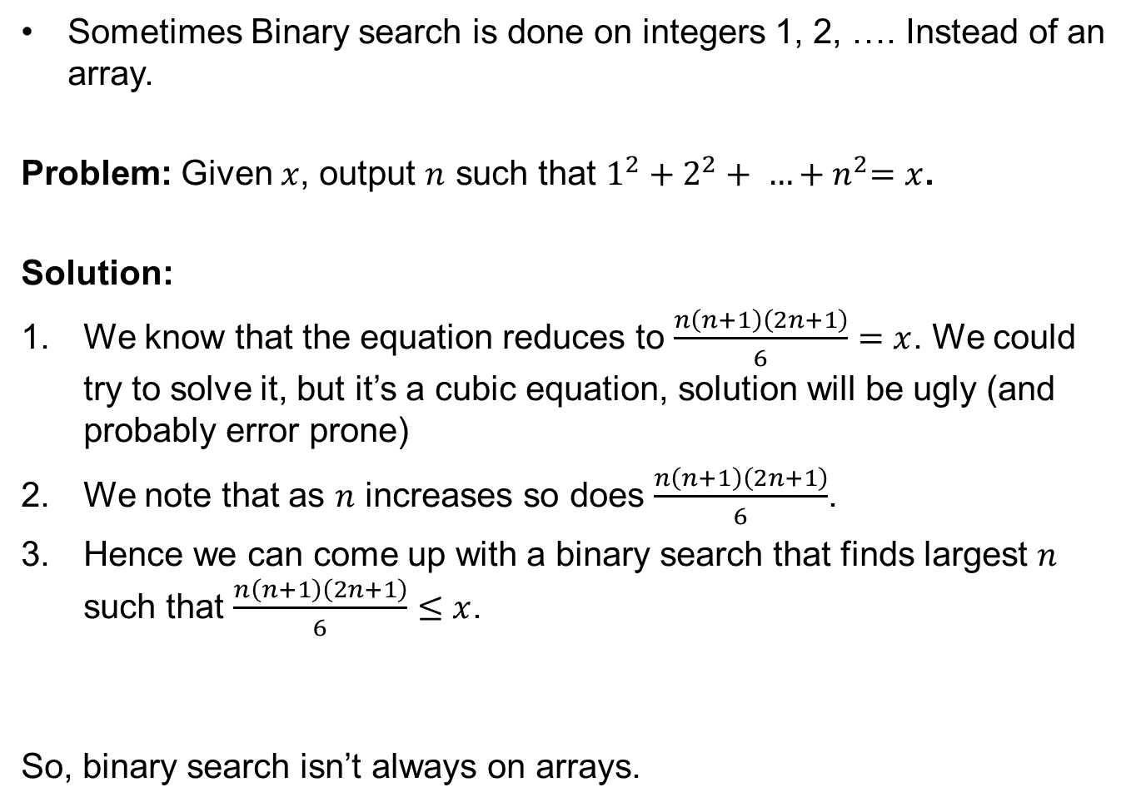
Sometimes Binary search is done on integers 1, 2, …. Instead of an array.
Problem: Given $x$, output $n$ such that $1^{2}+2^{2}+ …{+ n}^{2}=x$.
Solution:
We know that the equation reduces to $\frac{n\left(n+1\right)\left(2n+1\right)}{6}=x$. We could try to solve it, but it’s a cubic equation, solution will be ugly (and probably error prone)
We note that as $n$ increases so does $\frac{n\left(n+1\right)\left(2n+1\right)}{6}$.
Hence we can come up with a binary search that finds largest $n$ such that $\frac{n\left(n+1\right)\left(2n+1\right)}{6}≤x$.
So, binary search isn’t always on arrays.

Slide 21
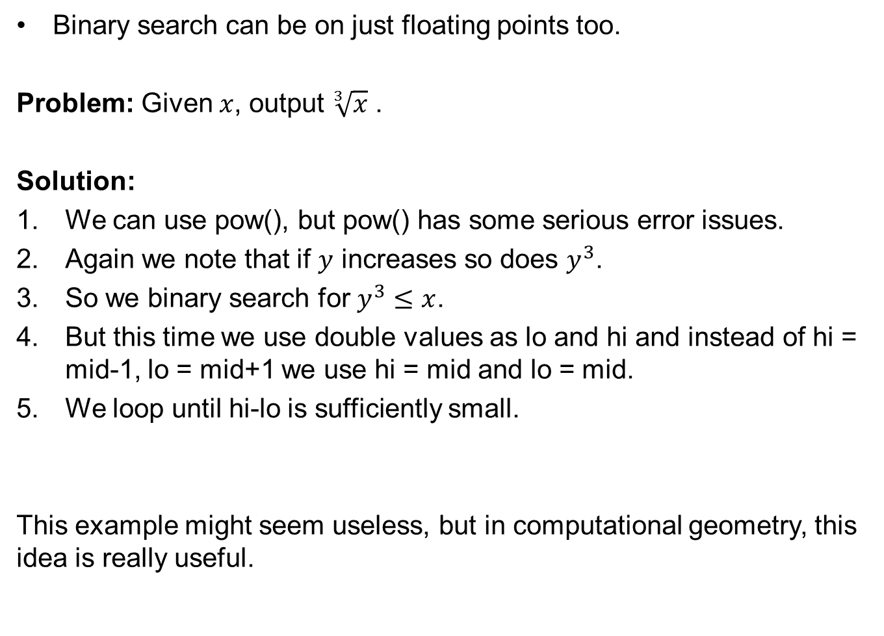
Binary search can be on just floating points too.
Problem: Given $x$, output $\sqrt[3]{x}$ .
Solution:
We can use pow(), but pow() has some serious error issues.
Again we note that if $y$ increases so does $y^{3}$.
So we binary search for $y^{3}≤x$.
But this time we use double values as lo and hi and instead of hi = mid-1, lo = mid+1 we use hi = mid and lo = mid.
We loop until hi-lo is sufficiently small.
This example might seem useless, but in computational geometry, this idea is really useful.

Slide 22
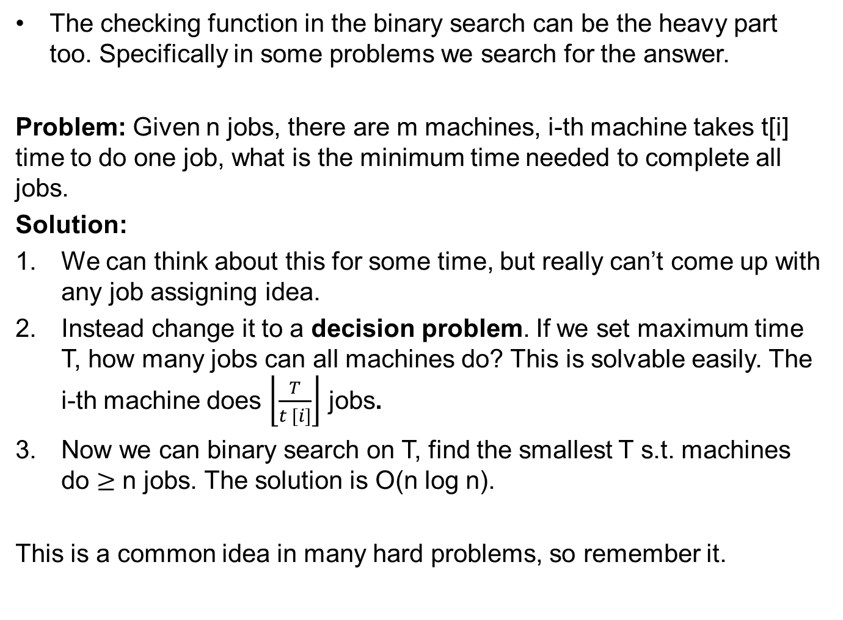
The checking function in the binary search can be the heavy part too. Specifically in some problems we search for the answer.
Problem: Given n jobs, there are m machines, i-th machine takes t[i] time to do one job, what is the minimum time needed to complete all jobs.
Solution:
We can think about this for some time, but really can’t come up with any job assigning idea.
Instead change it to a decision problem. If we set maximum time T, how many jobs can all machines do? This is solvable easily. The i-th machine does $\left\lfloor \frac{T}{t [i]}\right\rfloor$ jobs.
Now we can binary search on T, find the smallest T s.t. machines do $≥$ n jobs. The solution is O(n log n).
This is a common idea in many hard problems, so remember it.

